Slide 1


Final Presentation
Smart Attend

Slide 2
Motivation:
By observing some of the concerns faced by instructors in every class to track the attendance we were motivated to provide a solution to eradicate the issue.
Objective:
To bring ease in tracking the attendance for instructors.

Slide 3

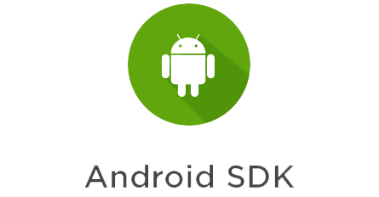



Implementation Environment
1. MongoDB
2. Express.js
3. Angular 7
4. Node.js
5. Ionic 4
6. Android SDK
7. X-Code
8. Heroku

Slide 4
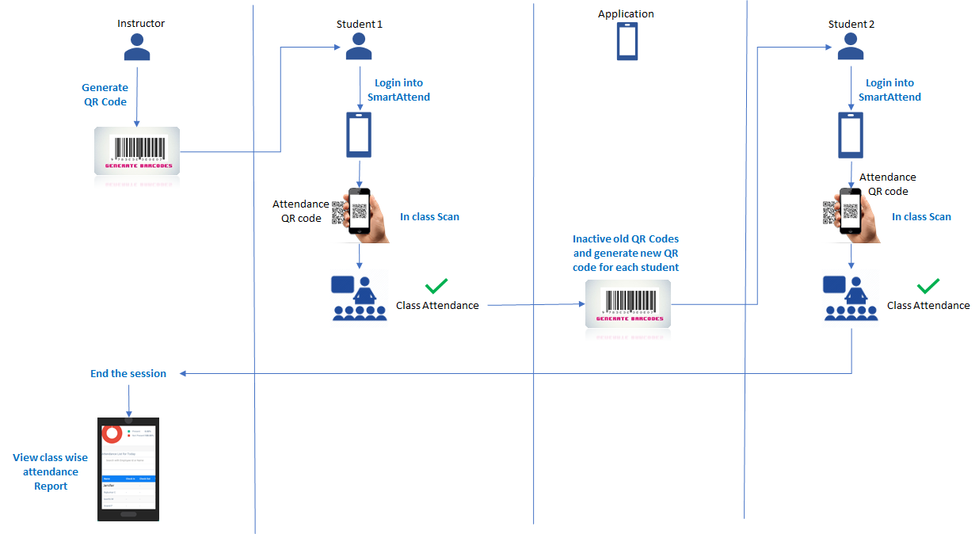
USE TRANSITIONS & SECTION DIVIDERS
Block Diagram
!
Consistency helps viewer see connections in the story – use same layout and design for individual sections and give your audience a mental check-point.

Slide 5
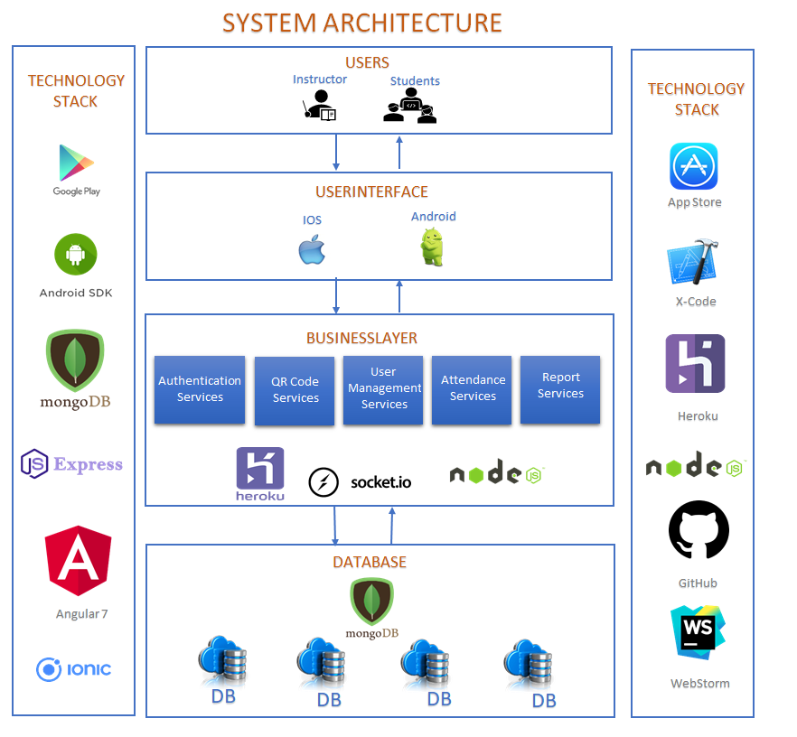
System Architecture
Fully Automated with CICD

Slide 6
PRODUCT JOURNEY
Research
System Architecture Design
Follow up meet with Choi ma’am
Implemented 6 features
Follow up meet with Choi ma’am
March 5th,2019
2
Start
1
INCREMENT-1
INCREMENT-2
Bug Fixes
Enhancements (from feedback)
Implemented 3 features
Follow up mails with Choi ma’am
Bug Fixes
Enhancements (from feedback)
Implemented 2 features
Follow up meet with Choi ma’am
V1.0
MILESTONE 1
Version-1.0 Release
April 23rd,2019
4
3
INCREMENT-4
INCREMENT-3
Smart Attend
March 1st2019 - May 1st 2019
V1.1
MILESTONE 2
MORE MILESTONES
Version-1.1 Release
April 30th,2019
5
INCREMENT-5
X
X
XX
Journey Continues…..

Slide 7
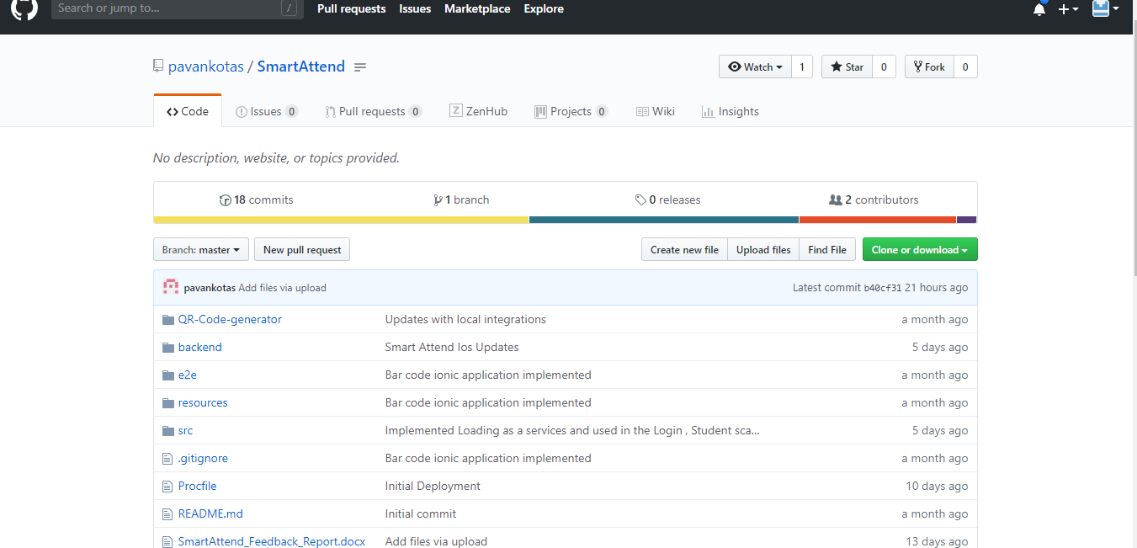
https://github.com/pavankotas/SmartAttend

Slide 8
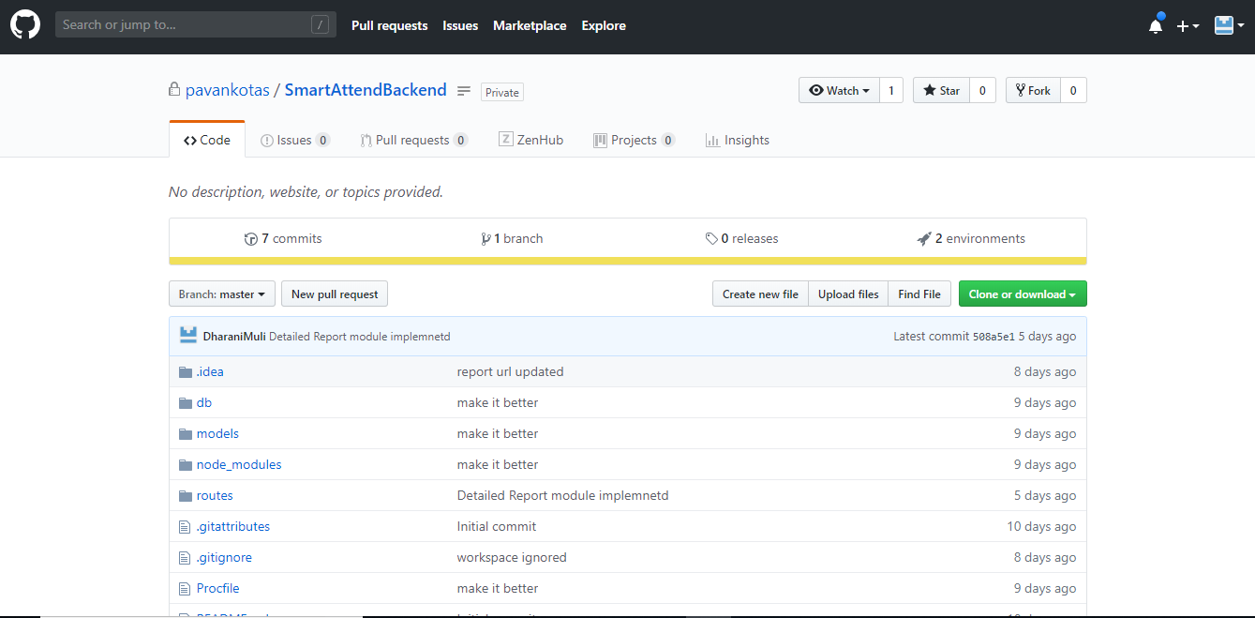
https://github.com/pavankotas/SmartAttendBackend

Slide 9
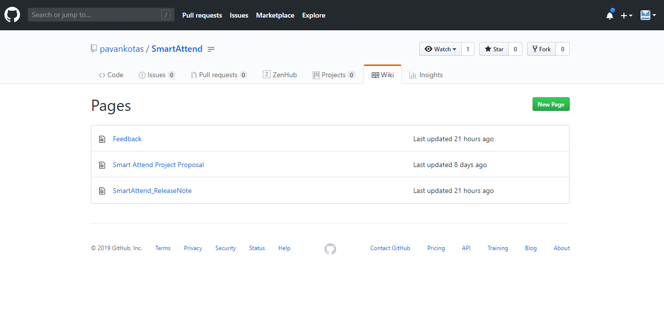
https://github.com/pavankotas/SmartAttend/wiki

Slide 10
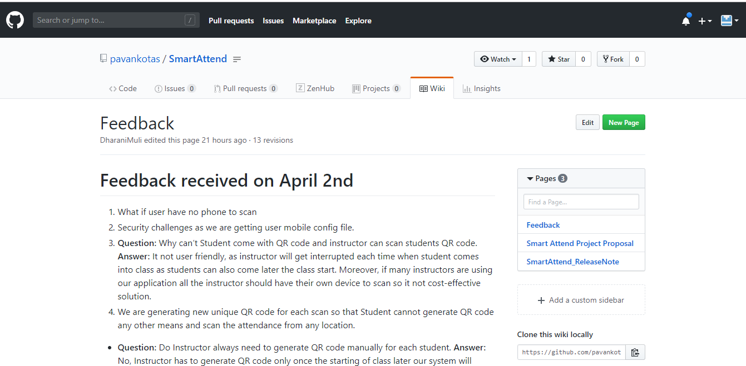
https://github.com/pavankotas/SmartAttend/wiki/Feedback

Slide 11
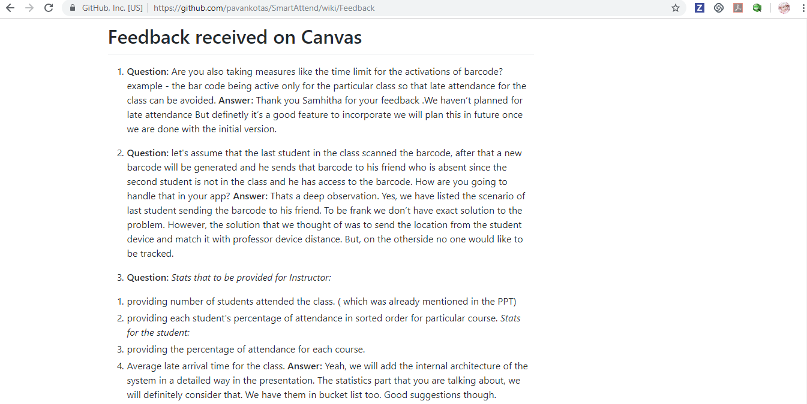
https://github.com/pavankotas/SmartAttend/wiki/Feedback

Slide 12

Future consideration:
Securable application.
User should request instructor to add attendance if they user is unable to
take the attendance.
Ex: if student don’t have phone.
Build Statistics
Late Attendance tracker
Course wise attendance.
Enhancements in Reports
Make Robust

Slide 13
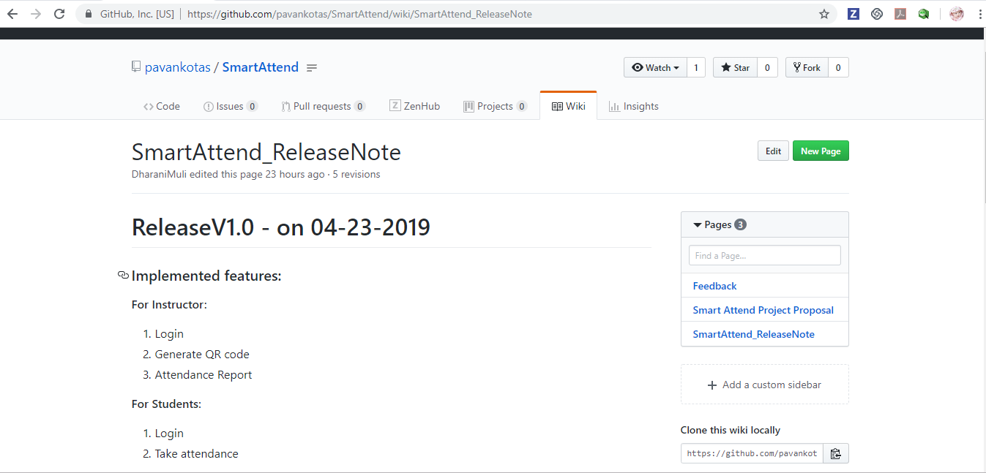
https://github.com/pavankotas/SmartAttend/wiki/SmartAttend_ReleaseNote

Slide 14
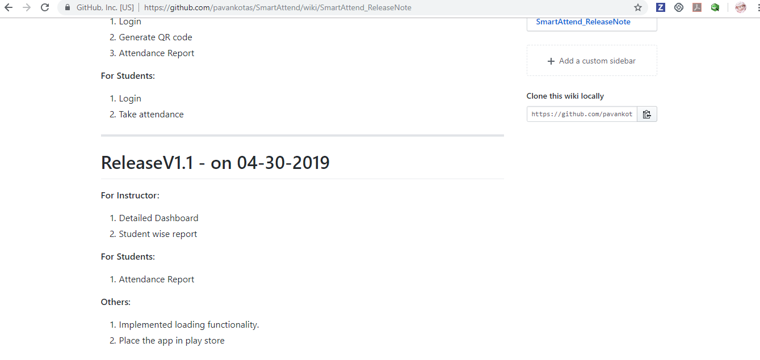
https://github.com/pavankotas/SmartAttend/wiki/SmartAttend_ReleaseNote

Slide 15
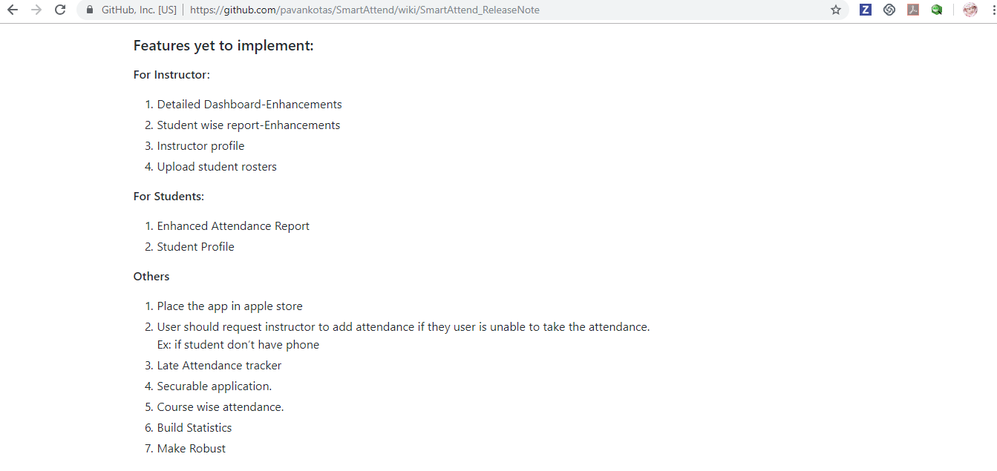
https://github.com/pavankotas/SmartAttend/wiki/SmartAttend_ReleaseNote

Slide 16
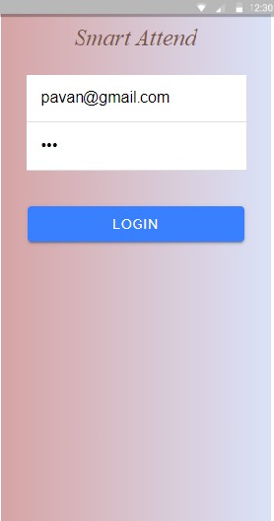
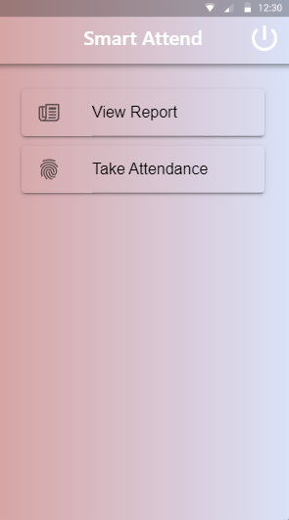
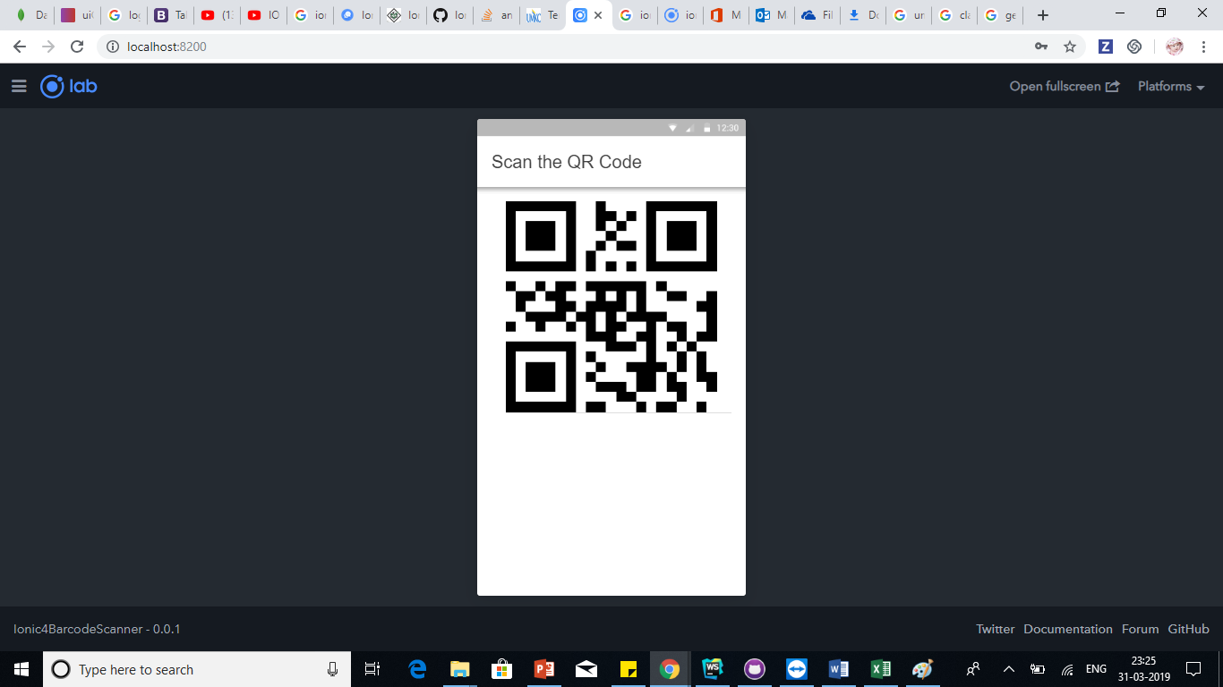
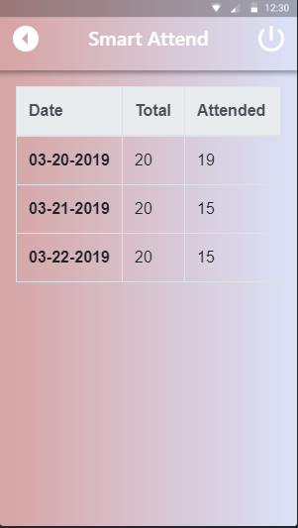
Professor Login
Home Page
Take Attendance
View Report

Slide 17
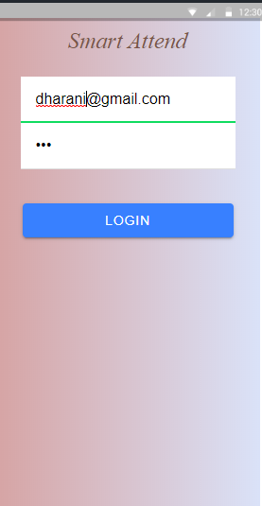
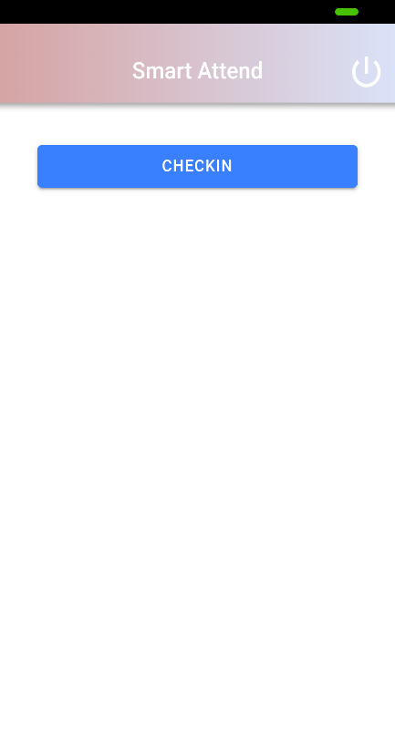
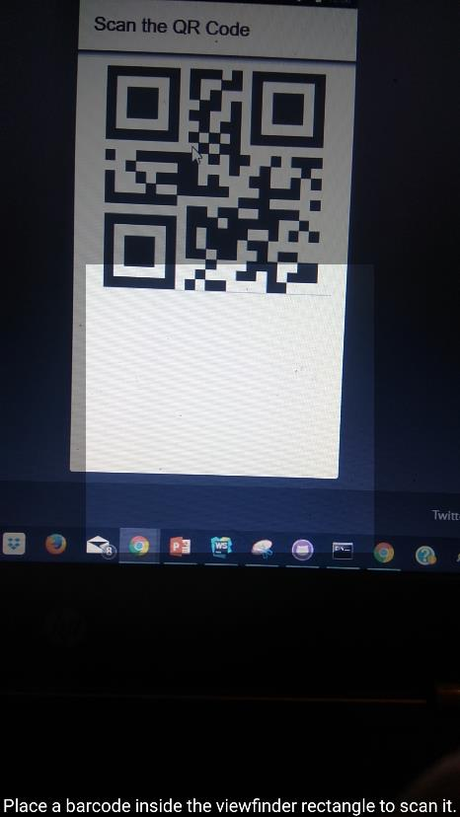
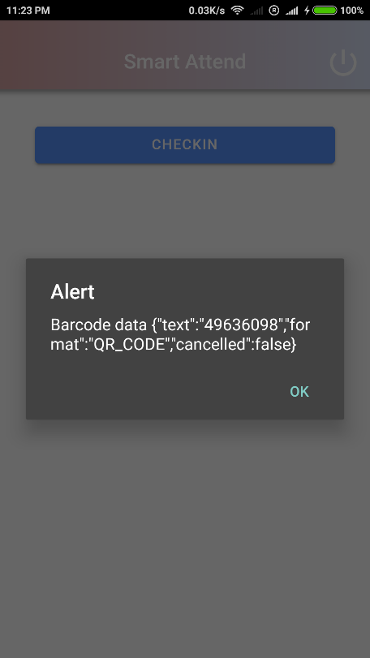
Student Login
Check in
Scan QR Code
Alert

Slide 18
Final Presentation
Smart Attend V1.1

Slide 19
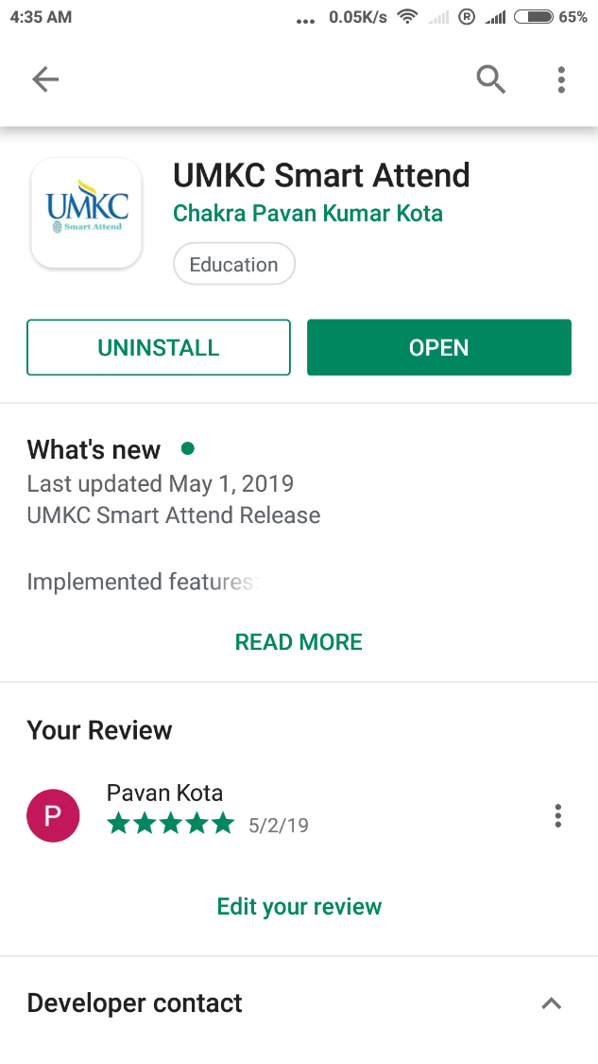
Play Store Deployment

Slide 20
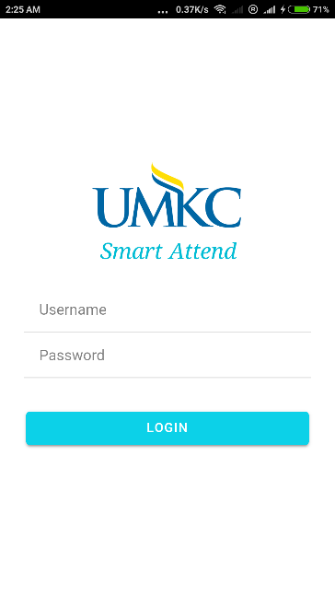
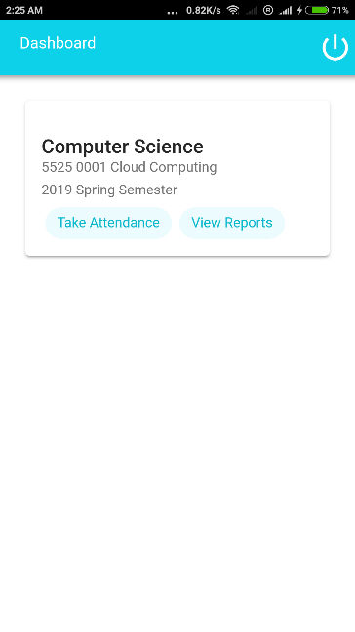
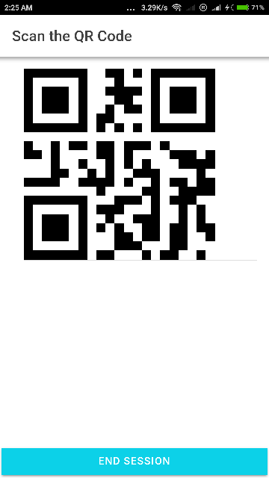
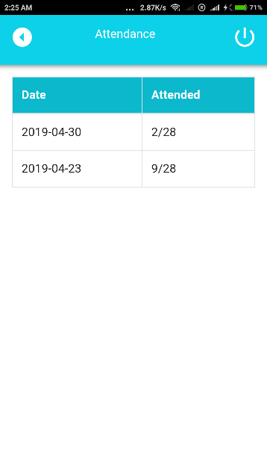
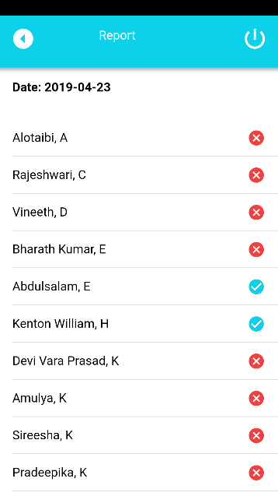
Android : Instructor app Screenshots
Screenshots

Slide 21
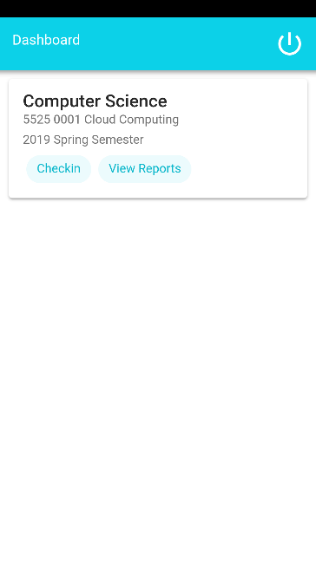
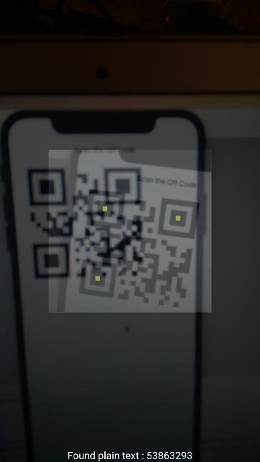
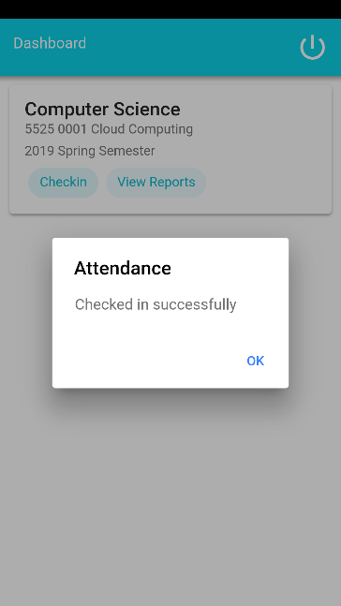
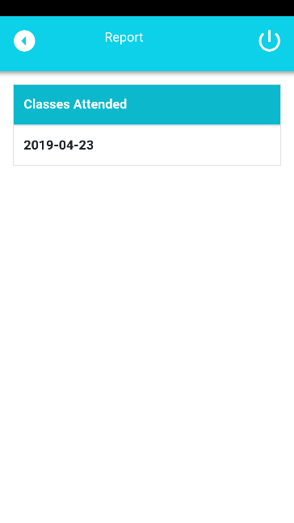
Android : Student app Screenshots
Screenshots

Slide 22
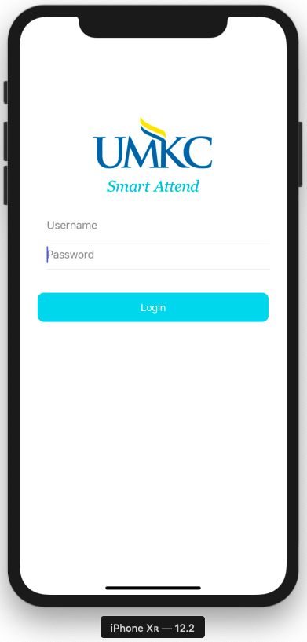
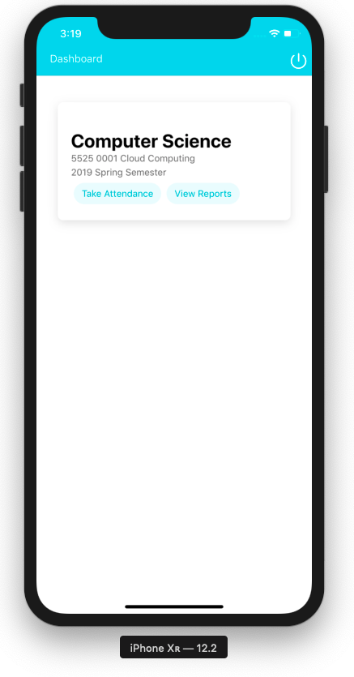
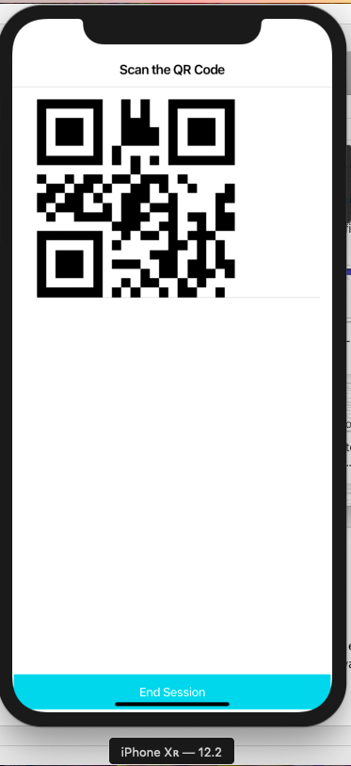
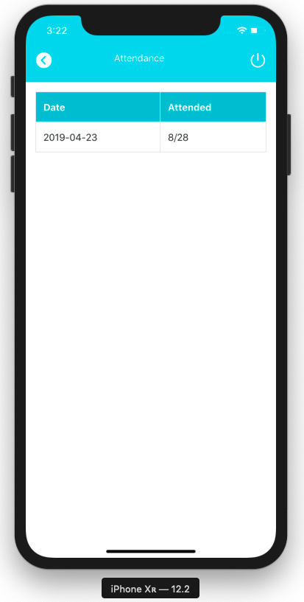
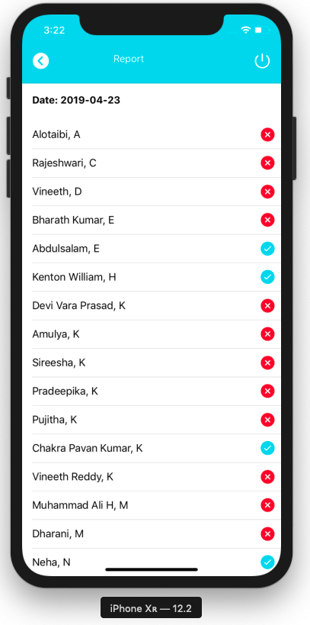
IOS : Instructor app Screenshots
Screenshots

Slide 23
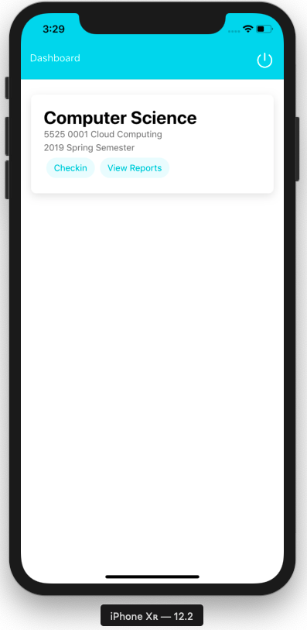
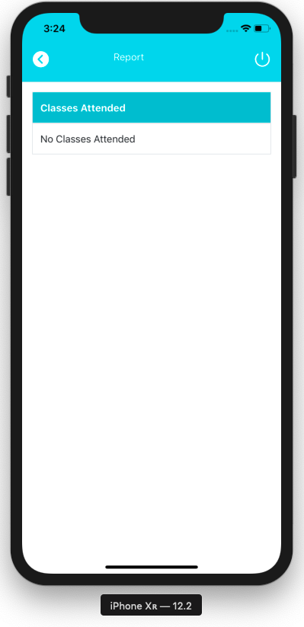
IOS : Student app Screenshots
Screenshots

Slide 24

Challenges and Findings
New QR code generation after every check in.
Socket implementation
Deployment is needed for every change in backend
Implemented CICD using GitHub and Heroku.
Digitally signing apk is a cumbersome process
Hunted through google documentation.

Slide 25

Product Outcomes
1
Built an attendance app
2
Easy to use
3
Support IOS and Android

Slide 26
Individual Outcomes
Team
Chakra Pavan Kumar, Kota
Dharani Muli
By end of the project I had hands-on experience on mentioned software tools.
Also gain knowledge of the best coding standards.
I will improve my collaboration skills working in a team.
By end of the project I had hands-on experience on mentioned software tools.
Explored the functionalities of cloud services.
Developed and published IOS and Android app.
Worked and collaborated in an efficient way with team.

Slide 27
Smart Attend
Thank you

